Slide 1
Rainfall Prediction
Group 5
Shreyas Sunku Padmanabha, Abhishek Pradhan, Sudhanshu Deshpande
November 30, 2023
George Washington University
Cloud Computing

Slide 2
Scope of the Project
Utilize Kaggle Weather Dataset: Utilize the "Weather Dataset (Rattle Package)" from Kaggle as the primary data source for weather analysis.
Data Preprocessing for AWS: Clean and preprocess the dataset to handle missing values and outliers, ensuring data quality and preparing it for deployment on AWS.
Statistical Analysis and Visualization: Conduct statistical analysis and data visualization to understand weather patterns and trends, making it suitable for AWS deployment.
Machine Learning Model Preparation: Develop machine learning models for weather prediction and anomaly detection, optimized for deployment on AWS cloud infrastructure.

Slide 3
Background
Observations were drawn from numerous weather stations. The daily observations are available from Climate Data Online - Map search.
An example of latest weather observations in Canberra: Canberra, Australian Capital Territory March 2023 Daily Weather Observations
Definitions adapted from http://www.bom.gov.au/climate/dwo/IDCJDW0000.shtml
Data source: http://www.bom.gov.au/climate/dwo/ and http://www.bom.gov.au/climate/data.

Slide 4
Dataset Description
Dataset Source: Kaggle
Overview: The dataset provides approximately 10 years of daily weather data from various locations across Australia.
Specifications:
Columns: 23
Observations: 145,000
Date Range: November 1, 2007, to June 24, 2017
Target Variable: "RainTomorrow"
Description: Predicts if it rained the following day.
Values: "Yes" (if rainfall ≥ 1mm) or "No"
Link for Reference:Kaggle Weather Dataset

Slide 5
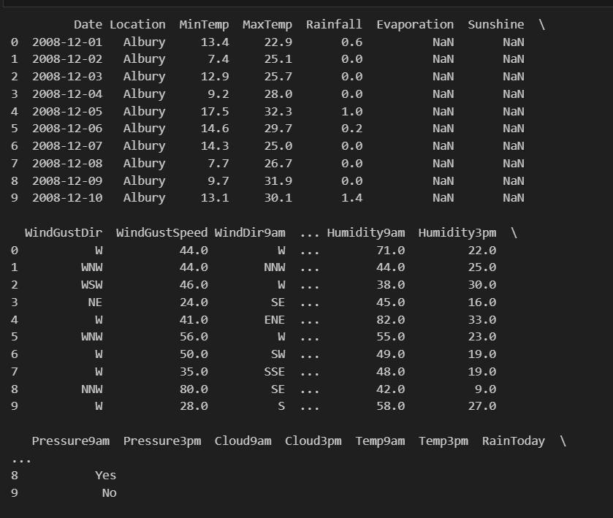
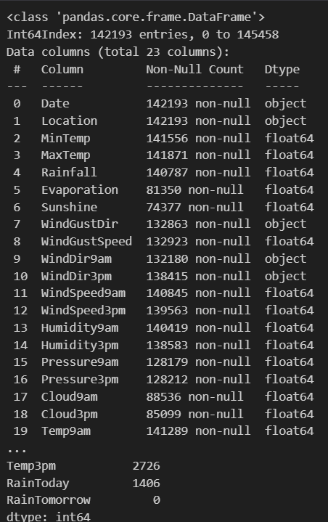
Dataset Description

Slide 6

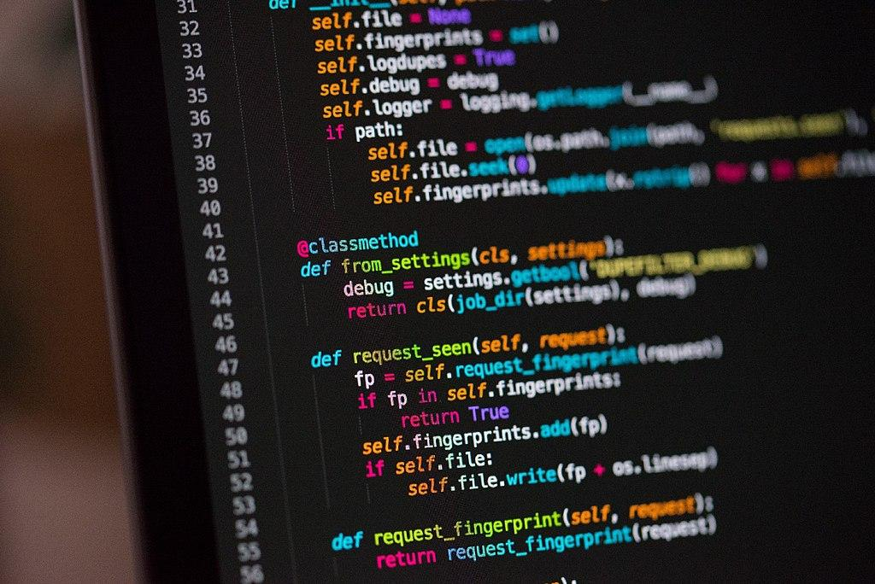
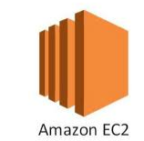


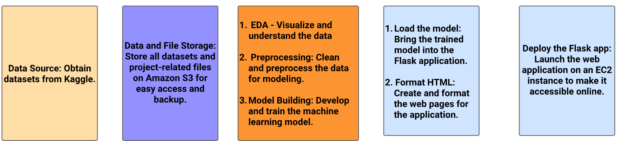
DATA FLOW

Slide 7
Data Pre-processing
In Data Pre processing we tried to understand the nature of the our dataset
Identify and address irregular data(both null values and missing values) using appropriate techniques.
Analyze the distribution of dataset features to assess their characteristics.
Convert categorical data into numerical values (e.g., one-hot encoding).

Slide 8
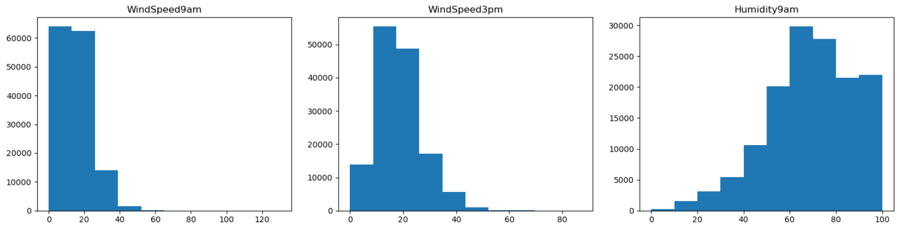
EDA
This is the distribution of some of the features that were used in the modelling

Slide 9
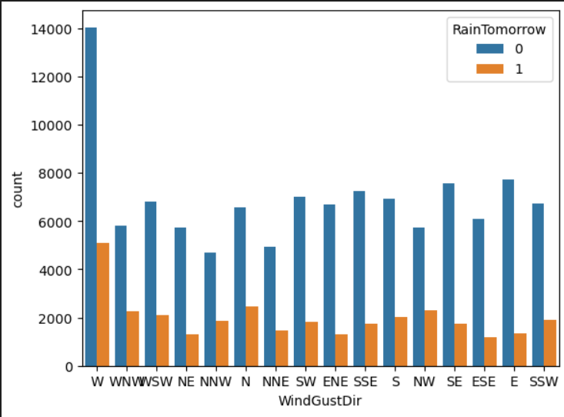
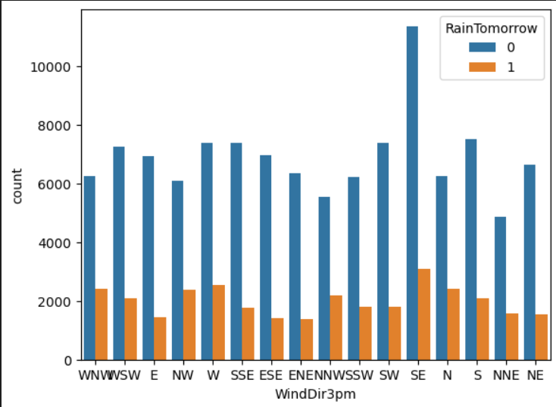
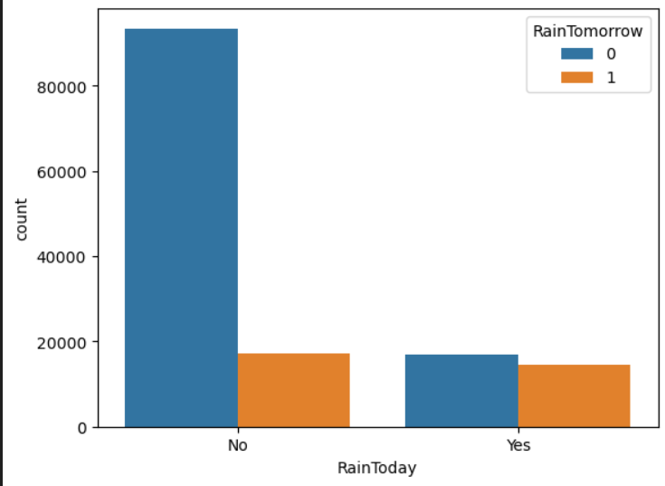
EDA

Slide 10
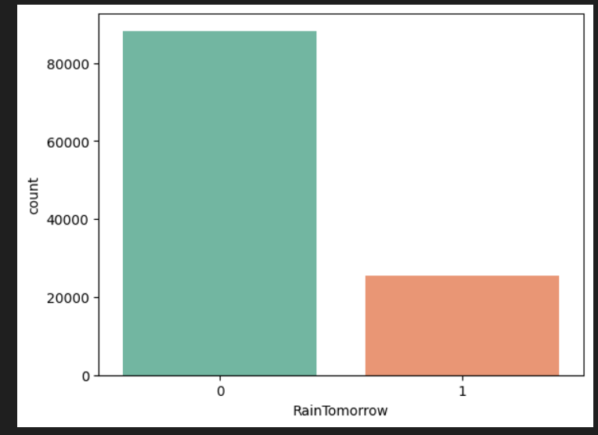
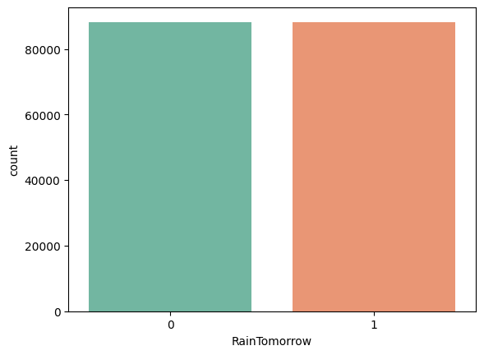
SMOTE Analysis
As we can see there is significant difference between two classes of Target variable, to address this we use SMOTE analysis on the target variable.

Slide 11
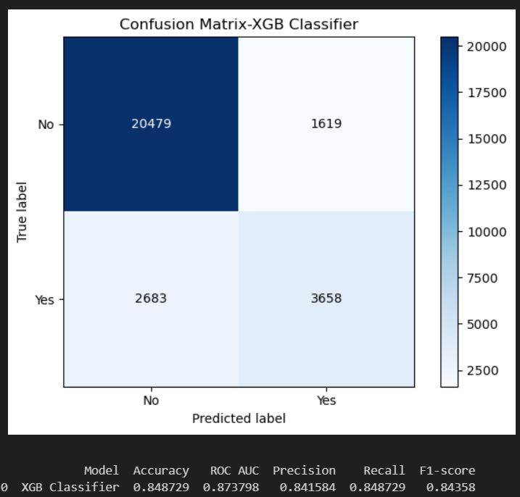
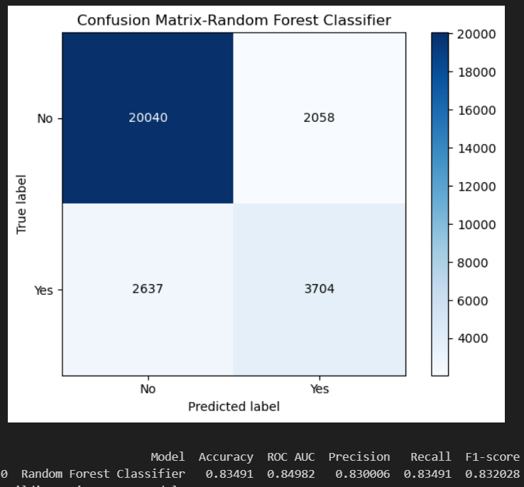
Machine Learning Modeling
We tried a total of 8 ML models, out of which these 2 showed the best performance:

Slide 12

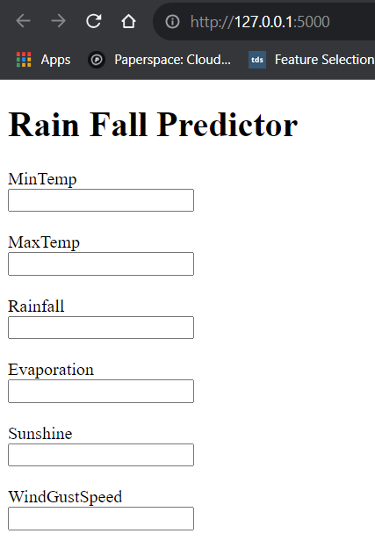

Final Result
We created this webpage, on which user can enter values and based on those values it will predict either rain or no rain

Slide 13
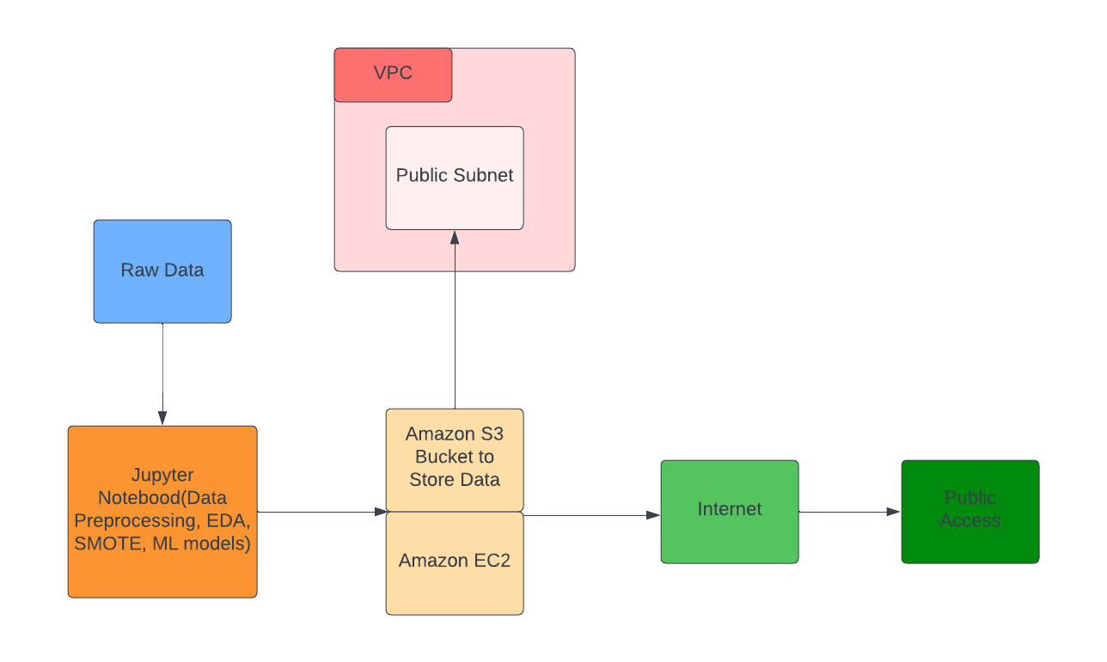
Project Flowchart
Notes:
Introduction:
"We're going to explore a project flowchart that outlines a cloud computing setup, primarily using Amazon Web Services (AWS), with a touch of Google services for data processing and model training."
1. Raw Data:
"Starting from the left, we have 'Raw Data'. This is the initial input or dataset that our project begins with."
2. Google Collab:
"This raw data is then fed into 'Google Collab', which is a platform provided by Google. Here, the data undergoes preprocessing, and if our project involves machine learning, the model training happens here."
3. Amazon Virtual Private Cloud (VPC):
"In the center, we see the 'VPC' or Virtual Private Cloud. Think of this as our own private space in the vast cloud universe of AWS."
Public Subnet: "Within the VPC, there's a 'Public Subnet'. Any resources we place here can communicate directly with the internet."
Private Subnet: "Below it is the 'Private Subnet', where resources are more isolated, not having direct access to the internet."
4. Amazon S3 (Simple Storage Service):
"Moving to the bottom-middle, we have 'Amazon S3'. It's a storage service provided by AWS."
"Our processed data or any other essential files are stored here. This service also hosts a website for our project."
"S3 has direct connectivity to the internet, meaning our stored data or website can be accessed online."
5. AWS Identity and Access Management (IAM):
"On the right side, we see the 'AWS IAM', which stands for Identity and Access Management. It's like the security guard of our setup."
Roles: "Here, 'Roles' are defined. These are sets of permissions that dictate who can do what within our AWS setup."
Permission: "Then, we assign 'Permissions' to these roles. For example, one role might be allowed to read data from S3, while another might have the permission to write data."
6. Public Access:
"Lastly, on the far right, there's 'Public access'. This indicates parts of our project that are openly accessible to anyone on the internet."
Conclusion:
"In summary, this flowchart presents a cloud-based project setup. We start with raw data, process it on Google Collab, and use AWS services like VPC and S3 to store, manage, and host our results, all while ensuring security and proper access control through IAM."

Slide 14
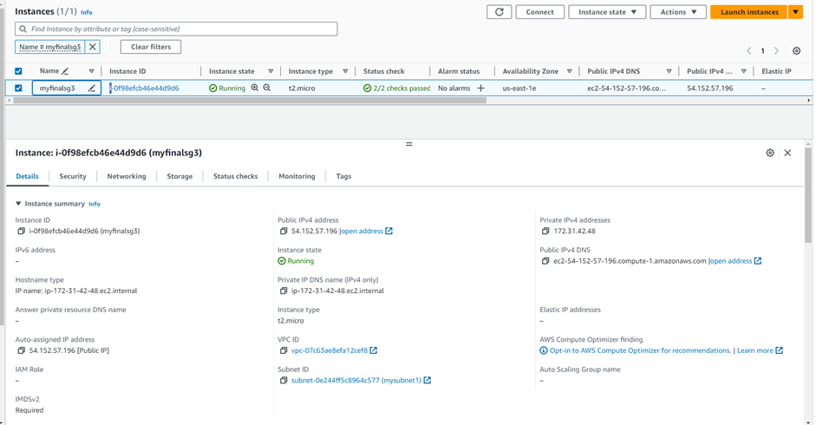
Creating EC2 Instance

Slide 15
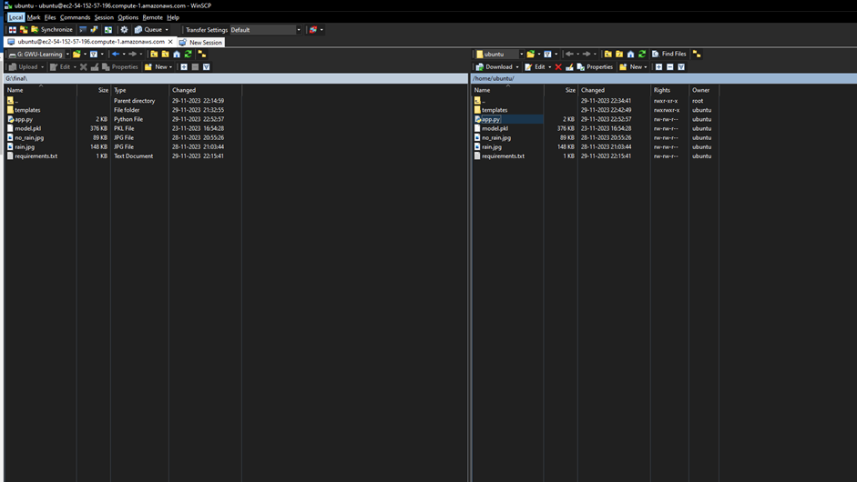
Using Putty to connect to Ubuntu Server

Slide 16
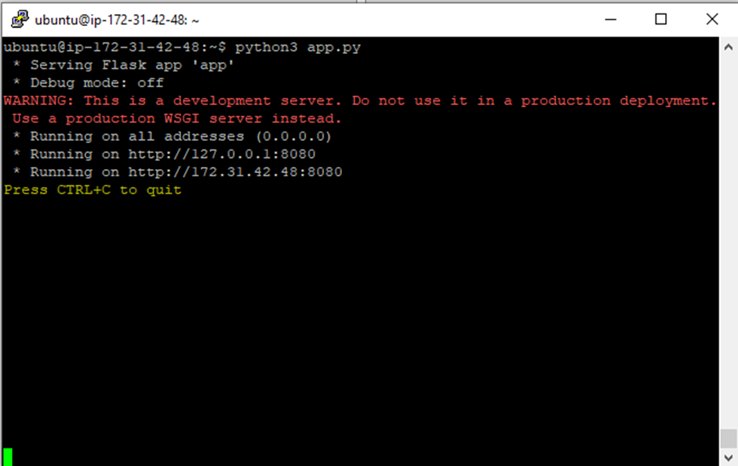
Executing Cmd on Ubuntu Server

Slide 17
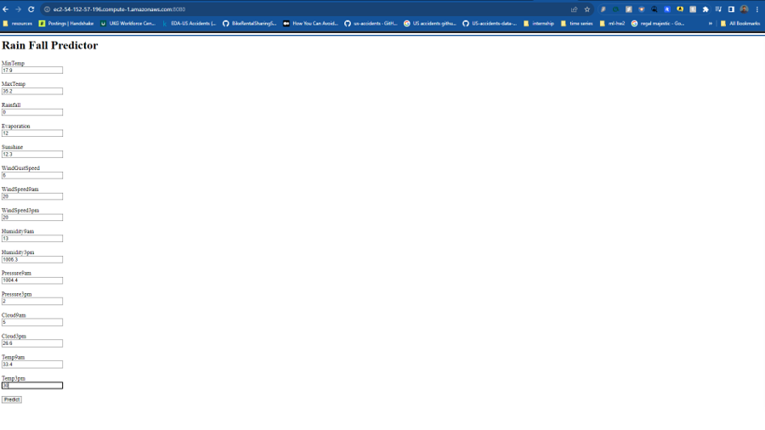
Result

Slide 18
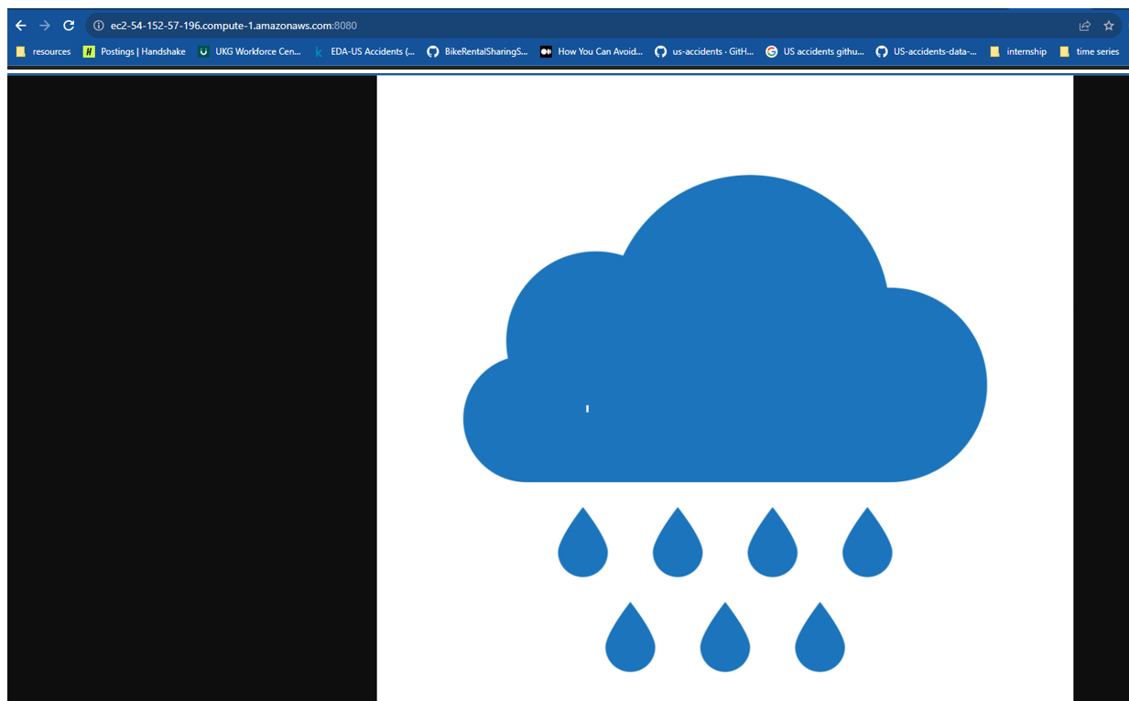
Result

Slide 19
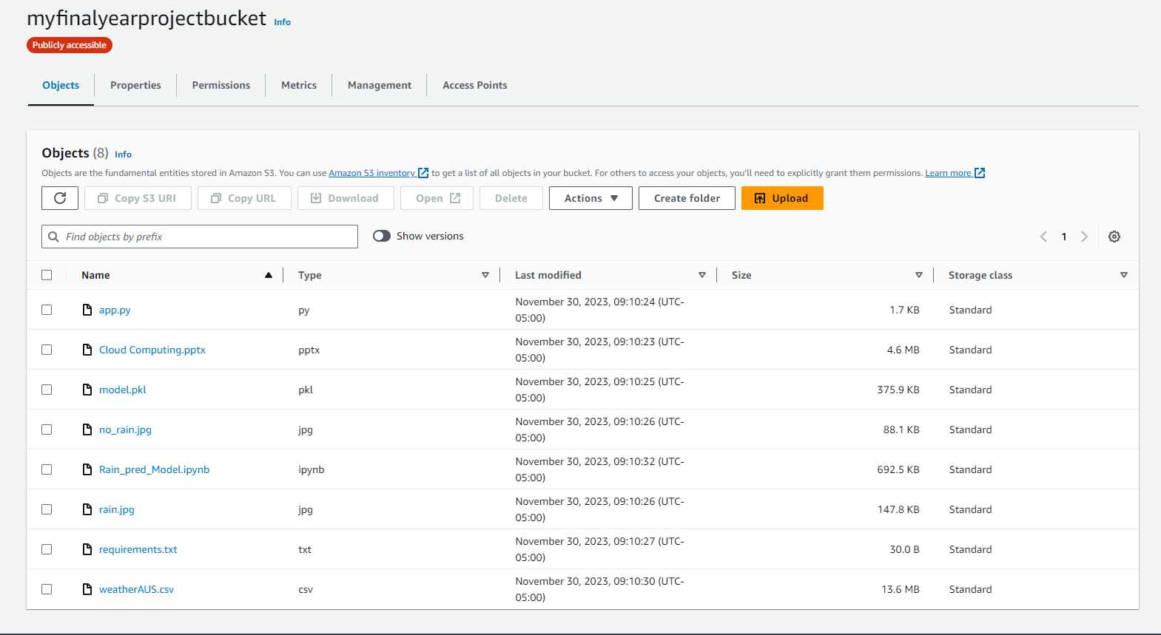
Store Objects in Amazon S3

Slide 20

Any Questions?

Slide 21

Thank you!

